Slide 1




Delta
Airlines
AIRLINE DATA
ANALYSIS

Slide 2

Overview
About The Company
Business Problem
Challenges
Objectives
Basic Insights
Seat Occupancy Analysis
Conclusion
01
02
03
04
05
06
07

Slide 3
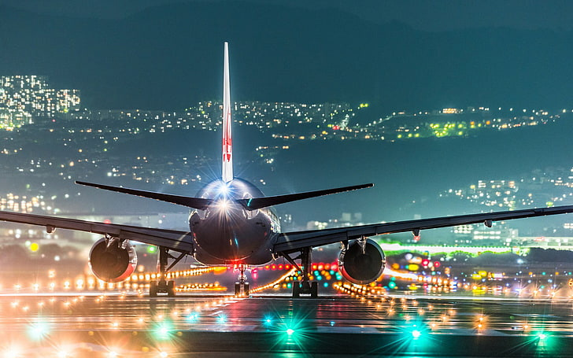

About the Company
Our company Delta Air Lines has been a leading provider of premium air transportation services for several years. We operate a diverse fleet of aircraft, from small business jets to medium-sized machines, offering tailored solutions for both corporate and individual clients. Our focus remains on providing safe, comfortable, and convenient travel experiences.

Slide 4

Business Problem
Despite our strong reputation and service quality, we are facing a series of challenges that threaten our profitability:
Stricter environmental regulations requiring more compliance, increasing operational costs.
Higher flight taxes leading to reduced profit margins on each trip.
Rising interest rates adding financial strain, impacting fleet expansion and other growth initiatives.
Increased fuel prices affecting operating expenses and reducing overall profits.
Tight labor market causing higher labor costs due to increased competition for skilled workers.
To address these issues, we are conducting an in-depth analysis of our flight data. Our goal is to identify strategies to boost occupancy rates and increase the average profit earned per seat, thereby alleviating some of the financial pressure caused by these external factors.

Slide 5
Challenges
Stricter Environmental Regulations
Growing global demand to reduce the airline industry’s carbon footprint has led to more stringent environmental laws. These regulations increase operational costs and limit expansion potential.
Higher Flight Taxes
Governments worldwide are imposing higher taxes on flights to address environmental concerns and raise revenue. This results in increased costs for airlines, which can lead to reduced demand for air travel.
Tight Labor Market and Rising Labor Costs
A shortage of skilled professionals in the aviation sector has caused labor costs to rise. Additionally, higher turnover rates are driving up recruitment and training expenses, further straining operational budgets.

Slide 6

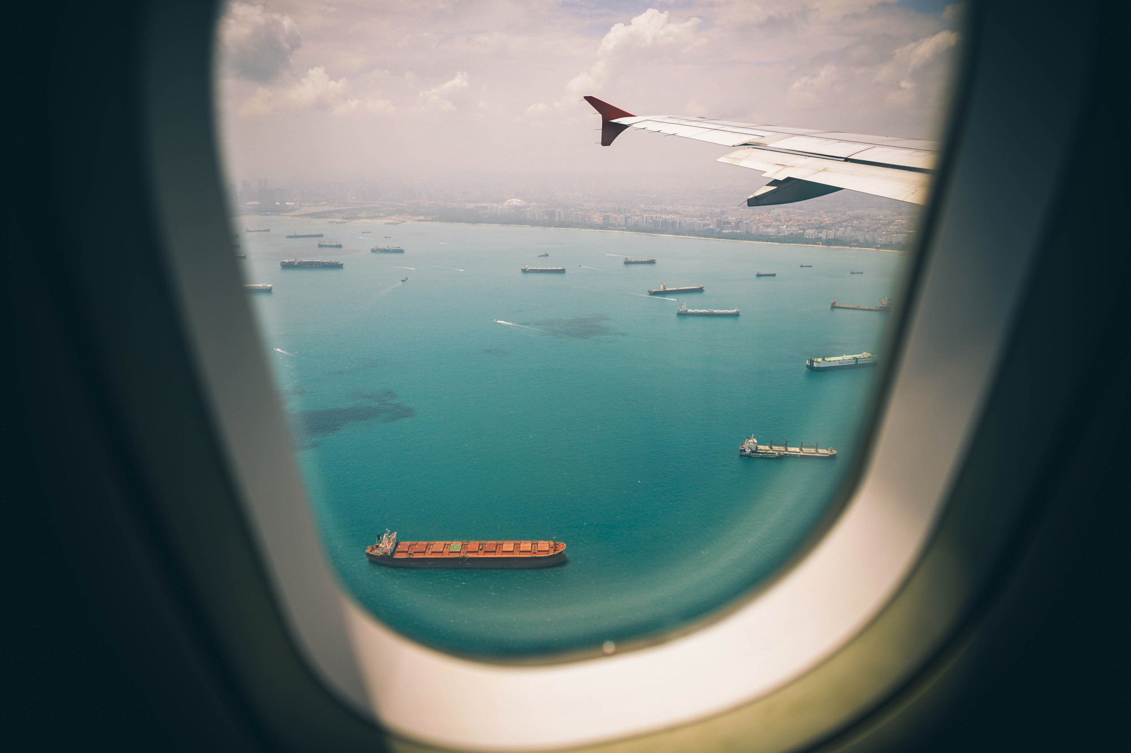

Objectives
Increase Occupancy Rate - By improving the occupancy rate, we can enhance the average profit per seat, helping to counter the financial challenges posed by rising costs and market pressures.
Improve Pricing Strategy - Adapting our pricing model to reflect market trends and customer preferences will be key to attracting more passengers and retaining our customer base in a competitive environment.
Enhance Customer Experience - Providing a seamless, convenient experience from booking to arrival will help us stand out in the market. This will foster stronger customer loyalty and encourage repeat business, which can drive long-term profitability.

Slide 7
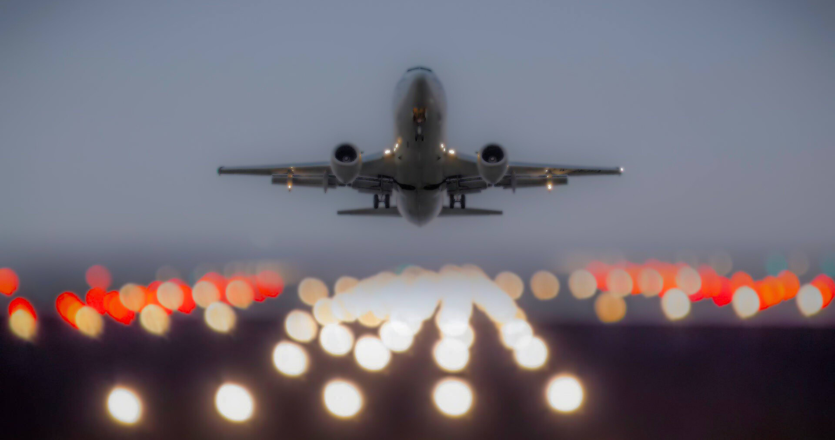
BASIC INSIGHTS

Slide 8

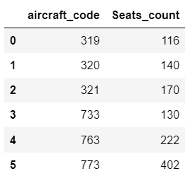
The basic analysis of the airline data reveals key insights that are crucial for developing strategies to increase occupancy rates and optimize pricing. One of the first insights is related to the aircraft fleet, specifically those with more than 100 seats. Table 1 provides a breakdown of the aircraft with over 100 seats, highlighting their seat capacity. This information is essential for understanding the available capacity and identifying opportunities to improve seat utilization across different aircraft types.
Table 1

Slide 9
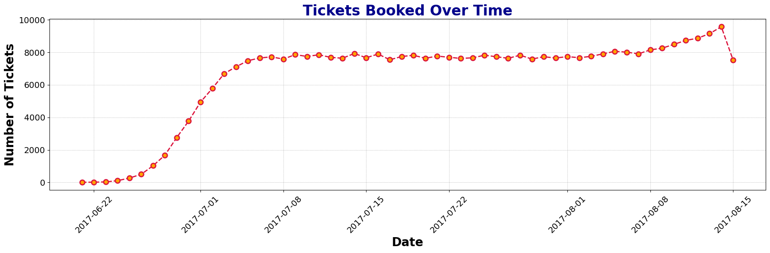
Figure 1
To further explore the dynamics of ticket bookings and revenue generation, a line chart was utilized to track these metrics over time. The analysis shows a gradual increase in the number of tickets booked from June 22nd to July 7th, followed by a stable trend from July 8th to August. Notably, there is a significant peak in ticket bookings on a specific day during this period.

Slide 10
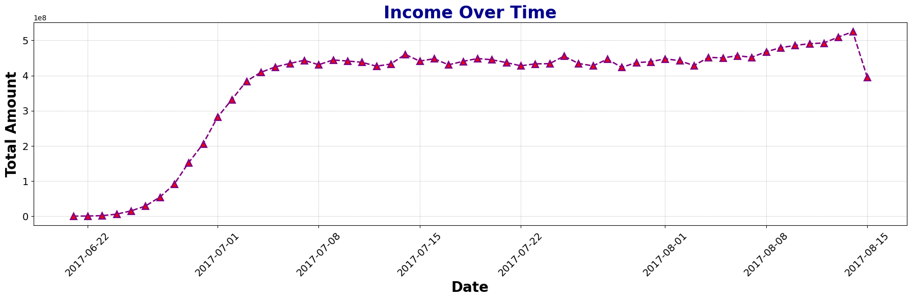
Figure 2
Since revenue is closely tied to ticket bookings, a similar pattern is observed in the total revenue earned. The peak in bookings suggests that identifying the factors driving this increase could help improve revenue and operational strategies in the future.

Slide 11
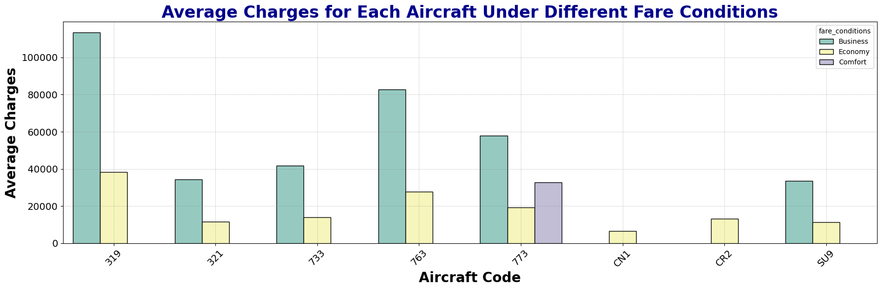
Additionally, we analyzed the average fare for different fare conditions i.e. Buisness, Economy and Comfort across various aircraft. A bar graph was used to compare fare conditions such as business, economy, and comfort classes. It is important to note that the comfort class is only available on one aircraft, the 773, while the CN1 and CR2 planes offer only the economy class. Across all aircraft, business class fares are consistently higher than economy class, regardless of the aircraft or fare condition. This pricing trend can be leveraged to adjust pricing strategies, particularly for business class passengers.
These insights provide a solid foundation for developing more detailed strategies aimed at increasing seat occupancy, optimizing pricing, and maximizing profitability for the airline.

Slide 12

SEAT OCCUPANCY ANALYSIS

Slide 13
In order to maximize profitability, it is essential for airlines to thoroughly analyze their revenue streams. Two key metrics that play a crucial role are the total revenue per year and the average revenue per ticket for each aircraft. These metrics help identify which aircraft and routes are generating the most income, allowing airlines to adjust their operations to focus on more profitable areas. This analysis also offers insights into pricing optimization opportunities and resource allocation for better revenue generation.

Slide 14
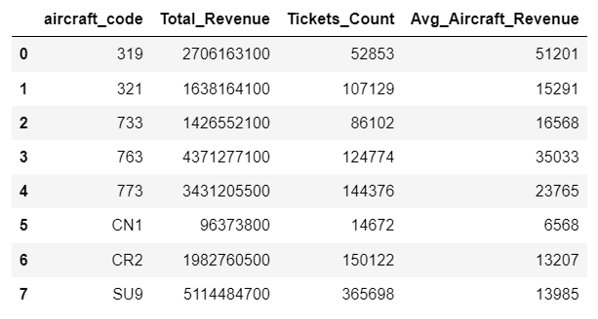
The analysis highlights that the aircraft with the highest total revenue is the SU9. Interestingly, the SU9 has the lowest prices for both business and economy classes, which may explain the high volume of ticket sales. In contrast, the CN1 aircraft generated the lowest total revenue. This could be attributed to the fact that it only offers economy class at a very low price, which may also reflect the aircraft's condition or fewer available facilities.

Slide 15
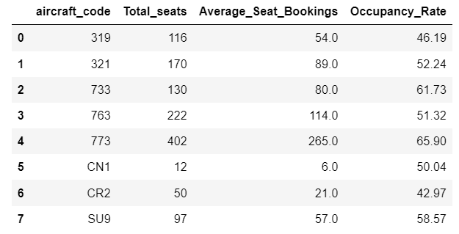
Understanding the average occupancy per aircraft is equally important. This metric reveals how effectively the airline is filling its seats and provides opportunities to improve occupancy rates, which in turn can boost revenue.
The occupancy rate is calculated by dividing the number of booked seats by the total available seats. Higher occupancy rates indicate that more seats are being booked, leaving fewer unbooked, which helps improve the airline's overall financial performance.

Slide 16
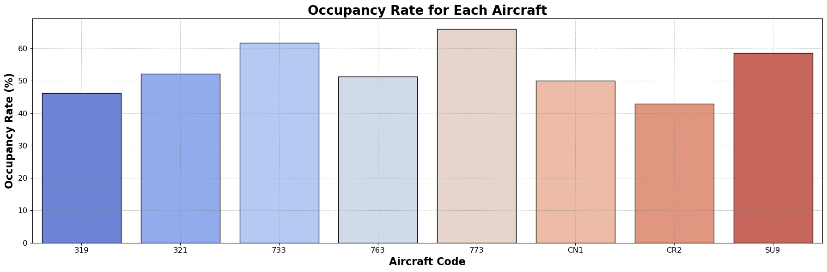
Figure 3
Figure 3 illustrates the average number of booked seats relative to the total number of seats for each aircraft. Higher occupancy rates indicate that more seats are being booked, leaving fewer unbooked, which helps improve the airline's overall financial performance. Aircraft 733 and 773 shows caparatively higher Occupancy Rates compared to others, while Aircraft 773 stands out at peak.

Slide 17
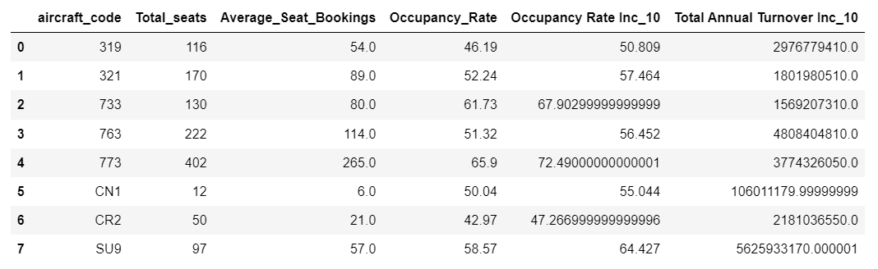
Airlines can simulate the impact of a 10% increase in occupancy rates to evaluate the potential improvement in annual revenue. This analysis provides valuable insights into how even a small increase in seat occupancy can lead to a gradual and significant rise in total revenue. By focusing on strategies such as optimizing pricing, improving flight schedules, and enhancing customer experience, airlines can not only increase occupancy but also offer greater value and service to their customers.

Slide 18
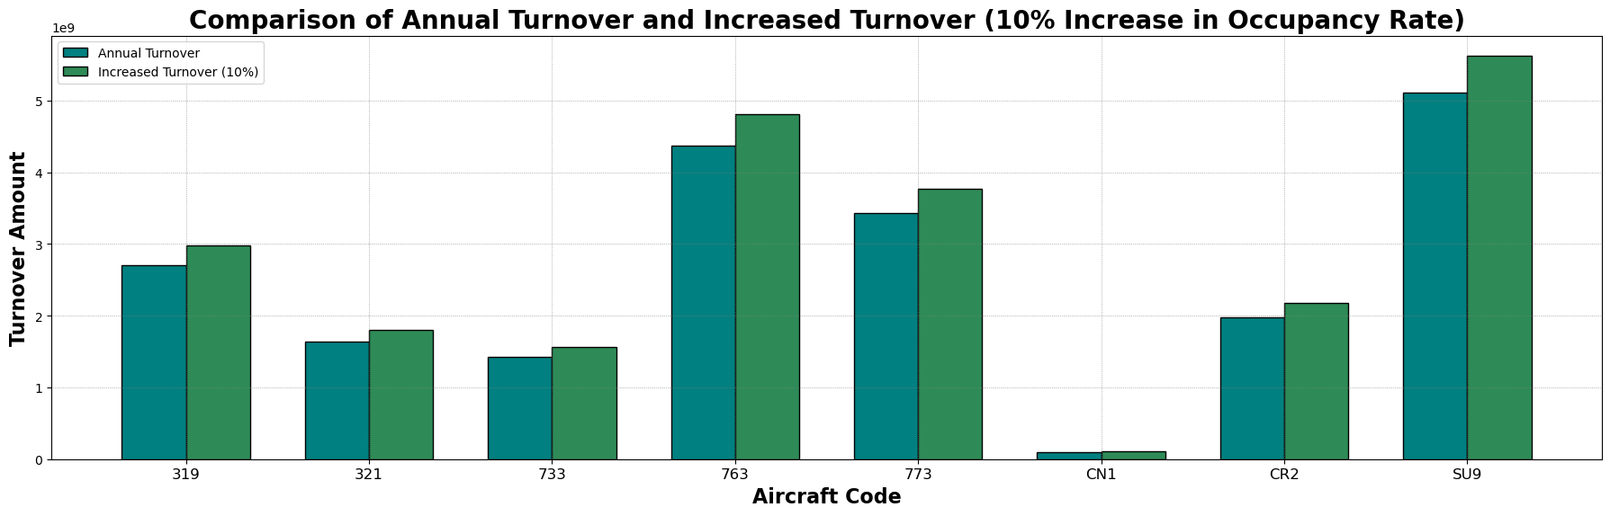
The figure shows how total revenue is projected to increase if airlines were to achieve a 10% higher occupancy rate across their fleet. The results suggest that pricing strategies will play a pivotal role in driving this improvement, reinforcing the need for a data-driven approach to setting fares and optimizing revenue streams.

Slide 19
Conclusion
In conclusion, analyzing key revenue metrics such as total revenue per year, average revenue per ticket, and average occupancy per aircraft is crucial for airlines aiming to maximize profitability. By assessing these indicators, airlines can identify areas for improvement and make necessary adjustments to their pricing strategies and route planning.
A higher occupancy rate plays a pivotal role in enhancing profitability, as it allows airlines to increase revenue while minimizing costs associated with vacant seats. It is essential for the airline to reassess pricing across different aircraft, as both excessively low and high prices are factors that deter ticket sales. Pricing should be set reasonably, taking into account the condition and amenities of each aircraft, ensuring it is neither too cheap nor too expensive.
However, increasing occupancy rates should not compromise customer satisfaction or safety. Striking a balance between profitability, service quality, and safety is critical. By adopting a data-driven approach to revenue analysis and optimization, airlines can achieve long-term success and sustainability in a highly competitive industry.

